Slide 1
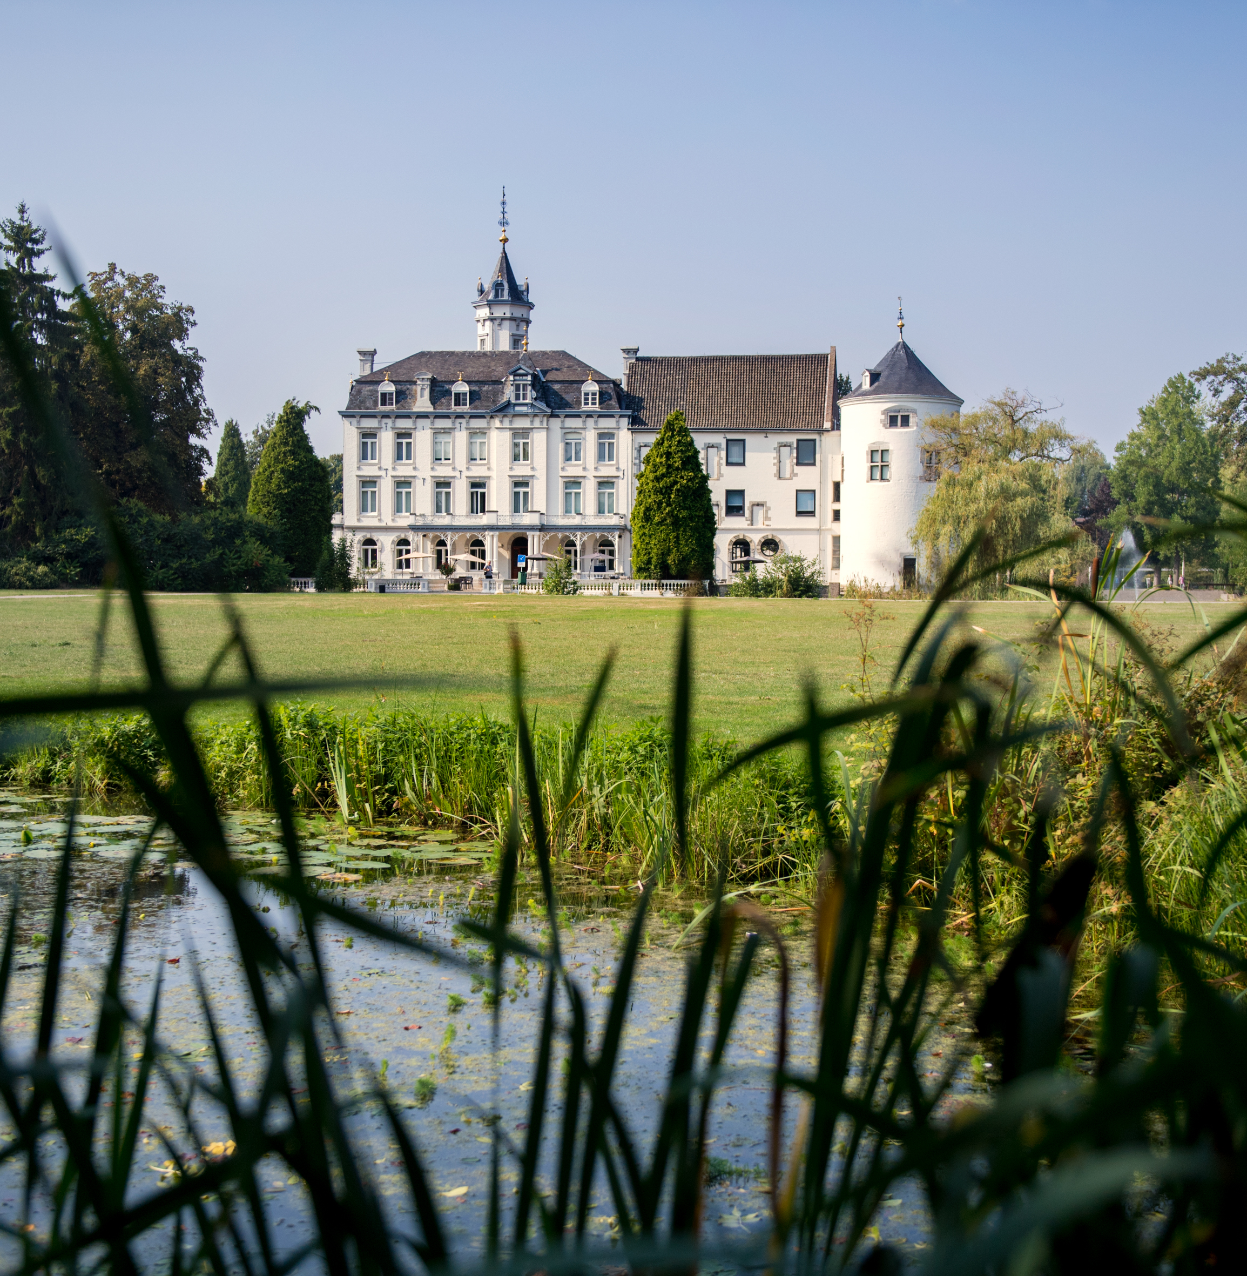
Welcome! Luc Houben (luc.houben@zuyd.nl)

Slide 2

What is Hospitality?
Offering people a warm welcome
Inviting someone in your home for a drink or meal
Making sure your visitors are comfortable
Giving gifts
Offering help or guidance
In a nutshell: Anywhere, where someone feels welcome!

Slide 3
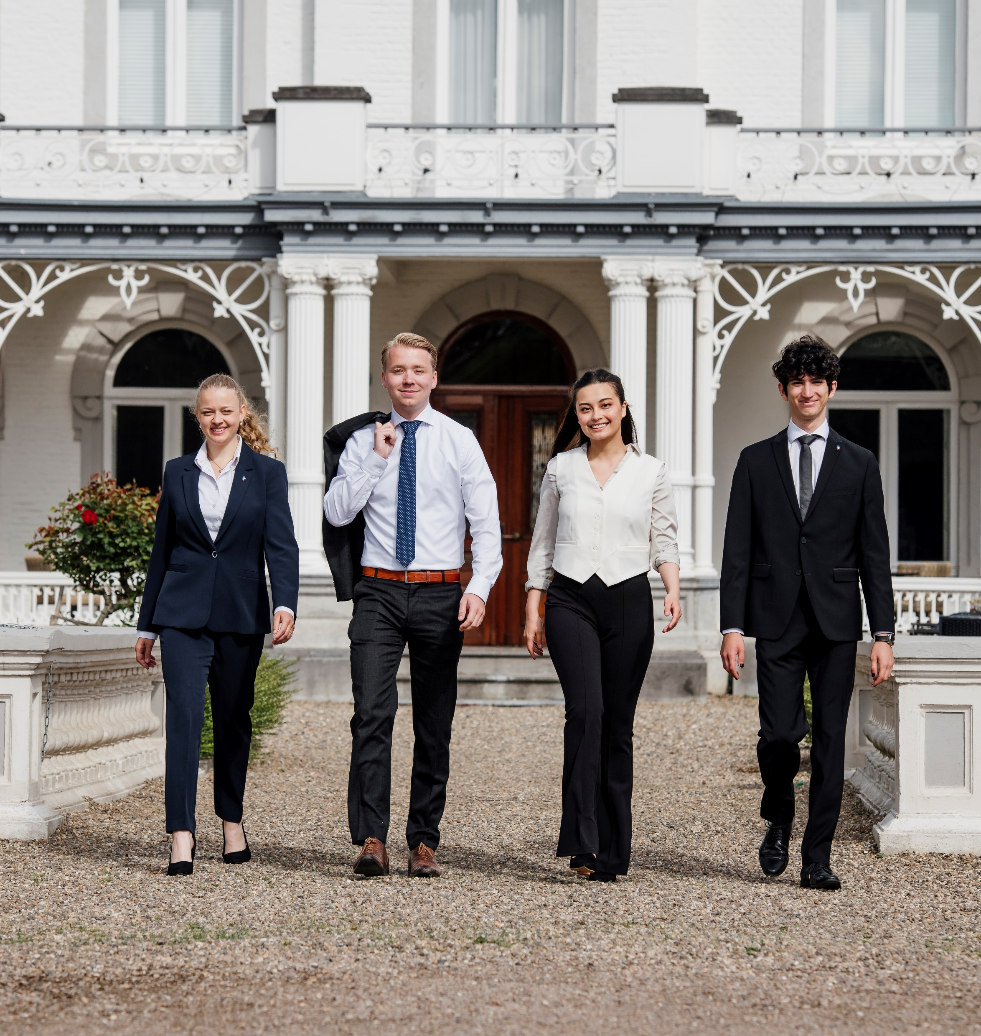
The Programme
Two intakes a year (September and February)
Language education
- English
- French, German, Spanish at A2 or Dutch (at beginners level)
3 graduation tracks
- Hotel Management
- Food Service
- Horizons in Hospitality
Two Internships
Combination of theory, practice, projects, real life assignments
Strong economic focus during programme

Slide 4
Bachelor of Arts
Management Accounting
Finance
Marketing & Communication
HR & Organisational Behaviour
Strategic & Change Management
Statistics
Languages

Slide 5
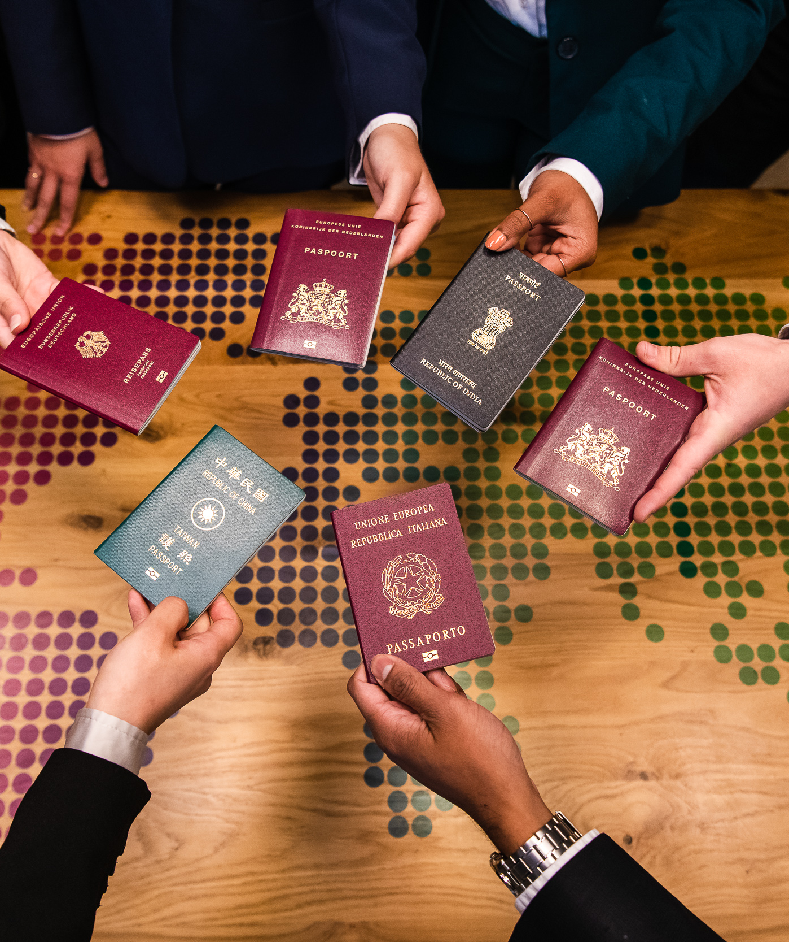

International character
>30 different nationalities – 15% international
International alumni network
>9000 alumni in 48 countries
Fully taught in English
6-18 months abroad
Choose your languages
Nationally and Internationally accredited

Slide 6
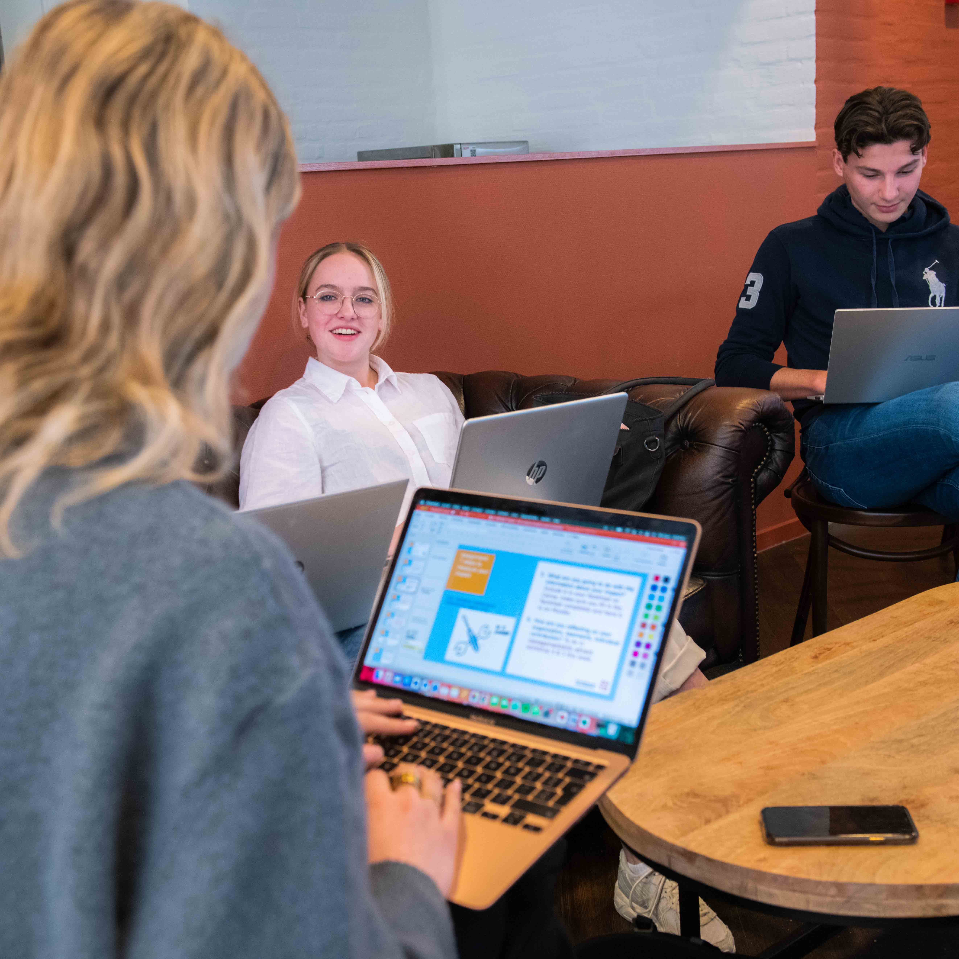
Small-scale and intensive programme
Groups of max. 15 students
Study success coach
Up-to-date study programme

Slide 7
HMSM Programme
Year 1
Year 2
Year 3
Year 4
Professional
Hospitality
The Employee Journey
Strategic and
Change Management
Management (consultancy) Project
Gastronomic
Hospitality
Performance Management
Innovative
Hospitality
Operational Internship
Minor 1
Int. Exchange Programme
Pre-Master
Management Internship
Intercultural
Hospitality
Minor 2

Slide 8
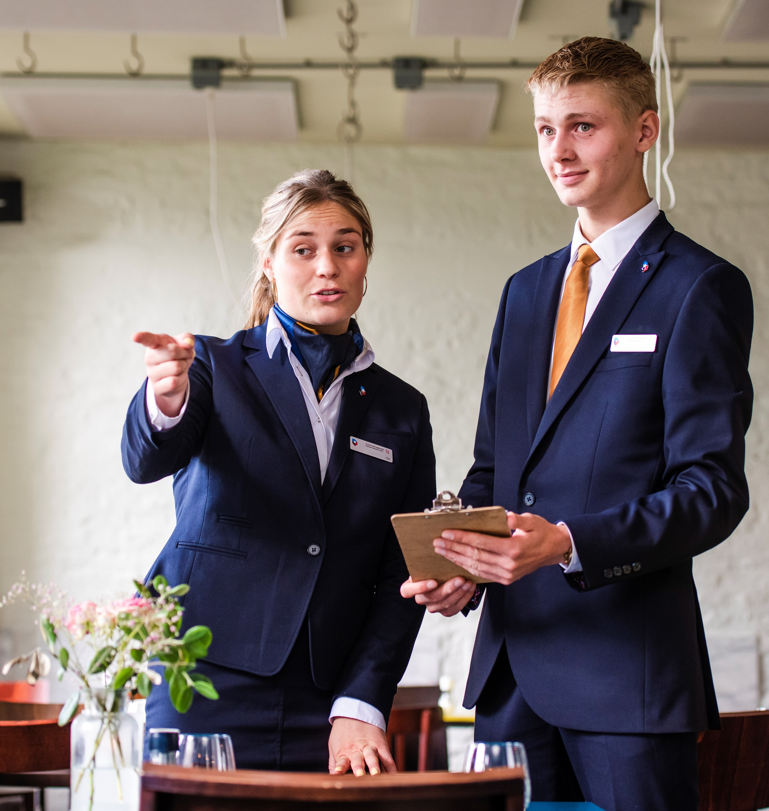
Teaching Hotel
26 unique rooms
Meeting rooms for 4 to 300 people
Restaurant L’Etoile and bar Le Coin
Unique learning environment
Practical first-half-year program at HMSM
All departments of the hotel always in combination with theory classes

Slide 9
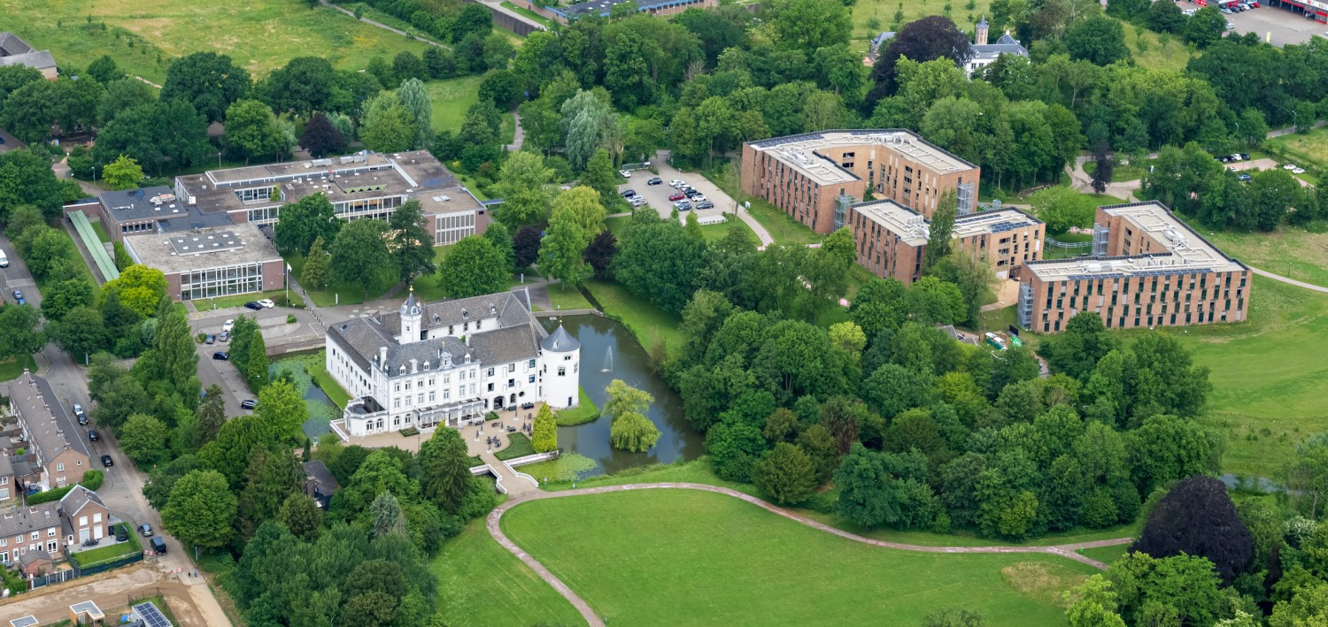
Campus life
Student Residence consists of 3 buildings
390 furnished student rooms with private bathroom
Surrounded by a beautiful park
The beating heart of our campus
Walking distance of education building and Teaching Hotel
10 minute bike-ride to the city centre of Maastricht

Slide 10
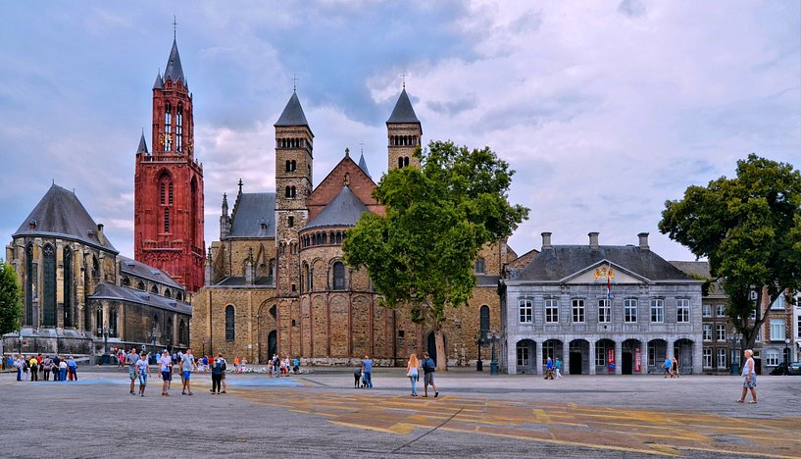
Maastricht - Student City
Maastricht students
In total 20.000 students with 50 % Internationals in the city
Gastronomy
Many restaurants and entertainment
Beautiful historic city center
Small scale
Safe
Visit different places within 1 hour
Germany/Cologne
Belgium

Slide 11
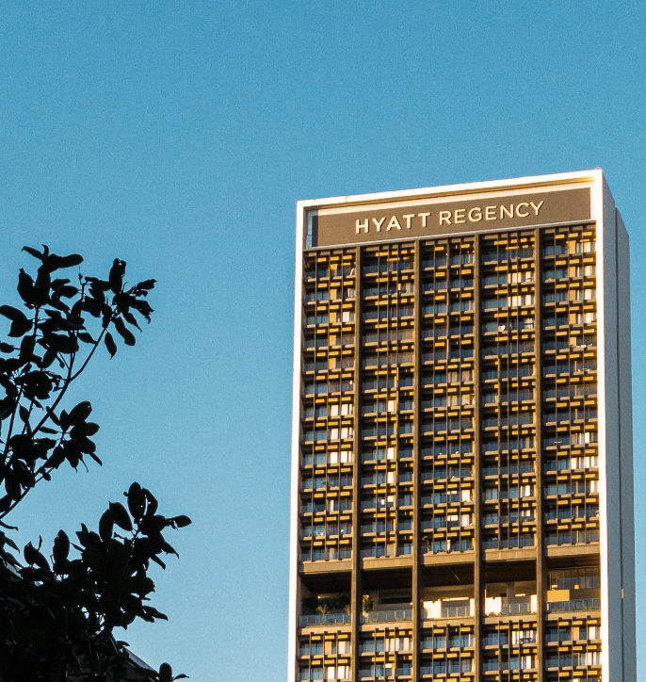
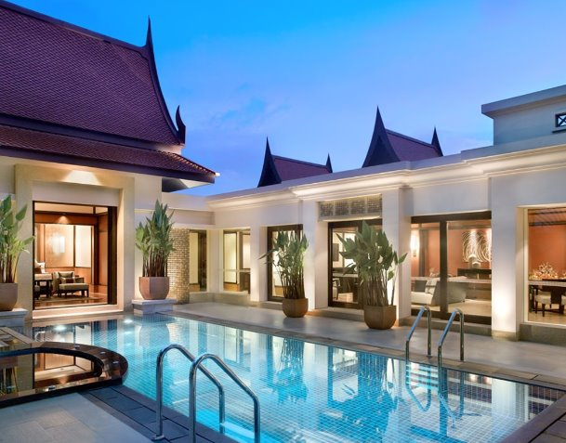
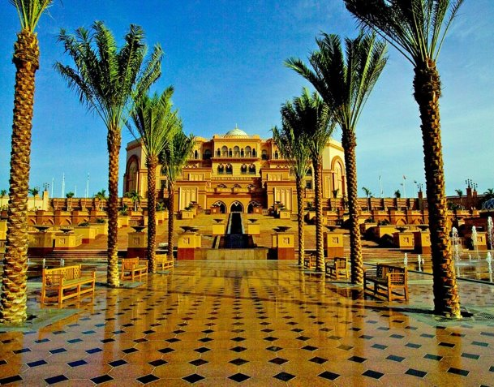
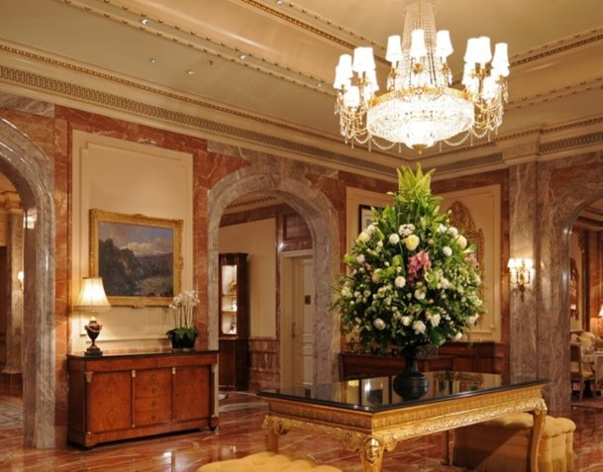
Year 2: International internship
The world is your playground
Operational level in 4**** or 5***** hotel
Internship office

Slide 12
HMSM Programme
Year 1
Year 2
Year 3
Year 4
Professional
Hospitality
The Employee Journey
Strategic and
Change Management
Management (consultancy) Project
Gastronomic
Hospitality
Performance Management
Innovative
Hospitality
Operational Internship
Minor 1
Int. Exchange Programme
Pre-Master
Management Internship
Intercultural
Hospitality
Minor 2

Slide 13
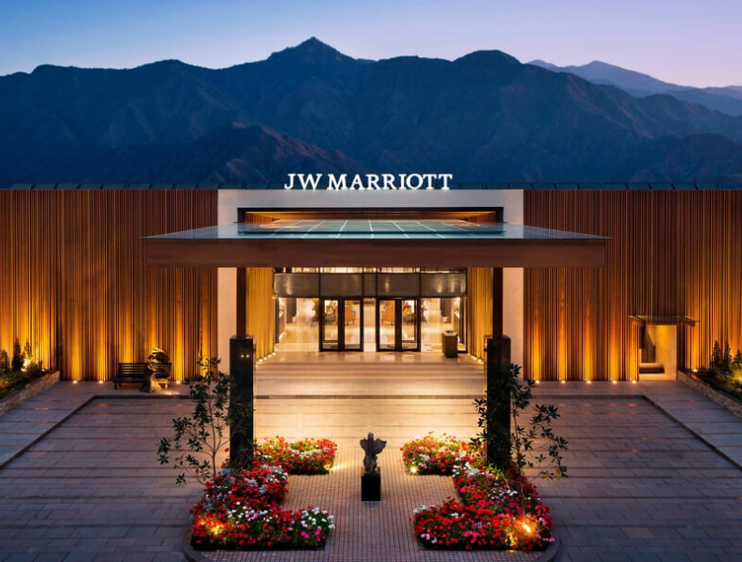
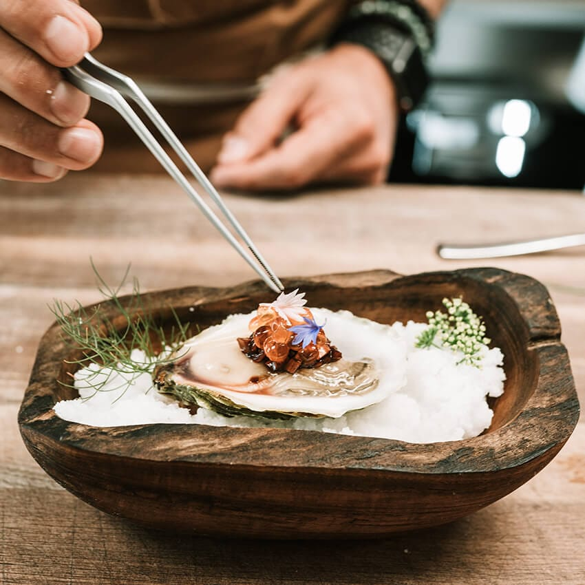

Choose your own graduation track
Hotel Management
Food Service
Horizons in Hospitality

Slide 14
Choose your minors
Hotel Management
Food Service
Horizons in Hospitality
Strategic Revenue & Real Estate Management
Haute Hospitality
Essentials in Foodservice
Gastronomic Experiences
Horizons in Hospitality
Leading People and Culture in a Changing World

Slide 15



More options
Minor
Exchange
Pre-master
Within Zuyd University of Applied Sciences
Follow an exchange programme abroad
Grants admission to the Master of International Business at UM & smooth transition into HMSM’s Master

Slide 16
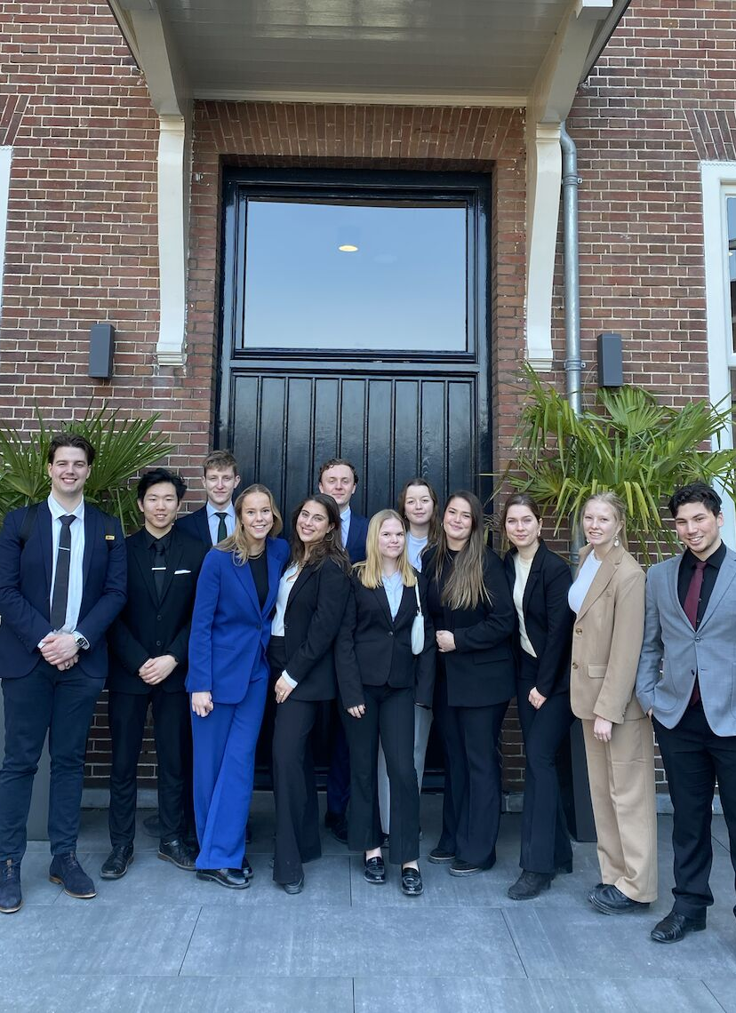
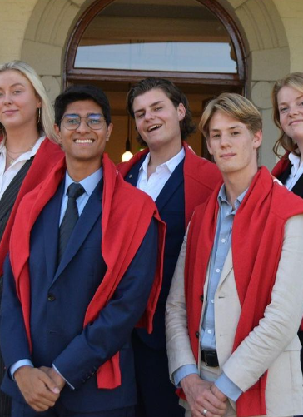
Extra-Curricular Activities
Excellence Programme
Student Council
Student Association Amphitryon
Participate in international student competitions in the Excellence Programme

Slide 17

Your career opportunities
30% starts a career in the Hotel Industry
20% starts a career in Food Service
20% starts a career in Horizons in Hospitality

Slide 18
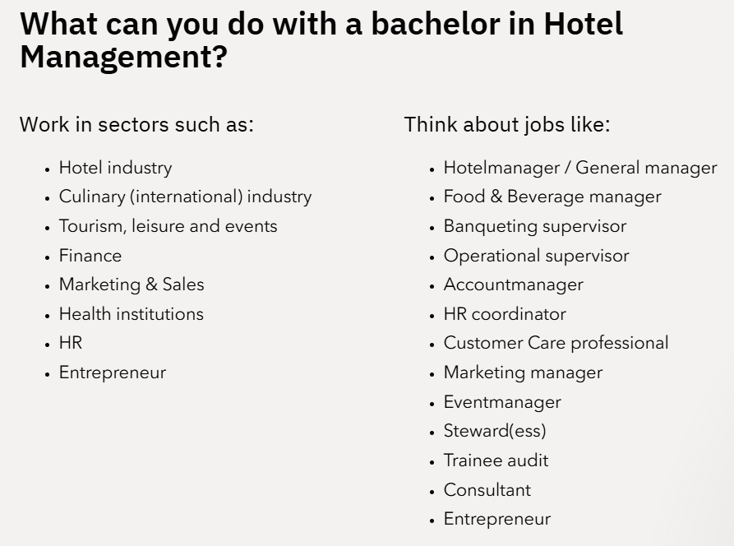

Slide 19
Careers in Hospitality
Careers after Hotelschool Maastricht - Alumni Stories

Slide 20
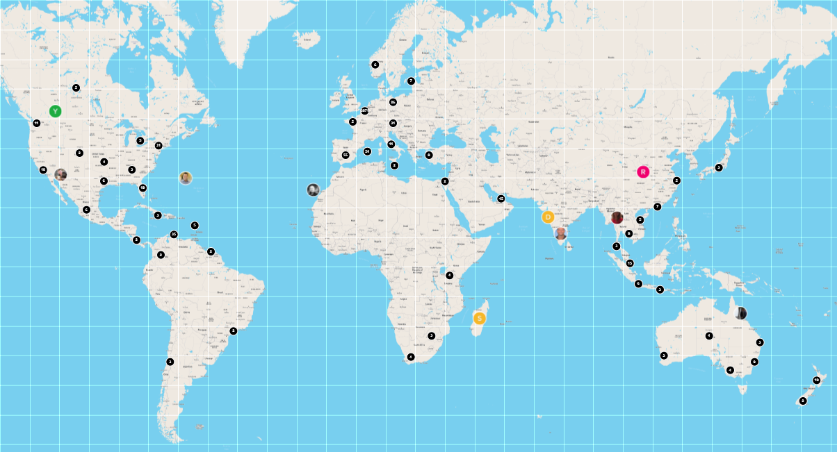
Alumni Community- networking!
HMSM has been a strong community since 1950
Nowadays: 9.500 alumni in 48 countries
Alumni office
personal contact
18% involved in HMSM ‘giving back’
Alumni platform (app):
Have your own online profile
Connect with each other worldwide
Alumni Chapters around the globe
Foundation HMSM
Notes:
Foundation HMSM is an initiave of alumni to support ambitious young talents with less financial resources

Slide 21
Admission requirements
HAVO
All profiles eligible
Economics recommended
For CM profile: economics is compulsory
VWO
All profiles eligible
Economics recommended
MBO
Level 4, with a preference for MHS/HOM

Slide 22
Admission requirements
Valid secondary school qualification for the programme
Candidates must demonstrate adequate proficiency in English
Proof of advanced knowledge of a second modern language
The A2 level is required for French, German or Spanish. Dutch will start at beginner’s level
Business related courses/related work experience recommended

Slide 23
Second language
Proof of advanced knowledge of a second modern language (for example: exam subject at school or acknowledged Language Certificate at A2 level or above):
French DELF/DALF ​
German Goethe Institut​
Spanish DELE of SIELE (from Instituto Cervantes)
For international students: Dutch (no prior knowledge required)
Send us your certificate before​
​September 1st (for enrolment in September) ​
or ​
December 1st (for enrolment in February)

Slide 24

Application and Selection procedure
Deadlines
Start September & February
1 October – 1 May
www.studielink.nl
Selection procedure
Phase 1
Phase 2

Slide 25
Thank you for your attention!
Questions?
Visit our campus!
Send us an e-mail if you like to come and visit
Study.hmsm@zuyd.nl
www.hotelschoolmaastricht.nl

